Slide 1
Worked Problems on Chapter 21

Slide 2
Mid term General Physics 2
21 October 2021 9-10:30 am
In person
1.5 hr exam
6Qs Problem solving on Coulomb’ Law and Gauss’s Law (you choose 4) (60%)
20 Multiple choice qs.(40%)

Slide 3
Three point charges are arranged along the x-axis. Charge q1 = +3.00 uC is at the origin, and charge q2 = -5.00 uC is at x = 0.200 m. Charge q3 = -8.00 uC. Where is q3 located if the net force on q1 is 7.00 N in the –x-direction ?
y
F_{Net}= 7.00 N
q3
q1
q2
F₃₁
F₂₁
-
+
-
x

Slide 4



$$F_{21}=9×{10}^{9}\frac{|\left(5.00×{10}^{−6} C\right)\left(3.00×{10}^{−6} C\right)|}{{0.200}^{2} m^{2}}=3.37 N$$
$${F_{Net}=F}_{3x}+F_{21x}$$
$$F_{Net}=k\frac{(−8.00×{10}^{−6} C)(3.00×{10}^{−6} C)}{r_{21}^{2}}+3.37 N=−7.00 N$$
$$9×{10}^{9}\frac{(−8.00×{10}^{−6} C)(3.00×{10}^{−6} C)}{x^{2}}=−10.37 N$$
$$x^{2}=9×{10}^{9}\frac{(−8.00×{10}^{−6} C)(3.00×{10}^{−6} C)}{−7.00 N+3.37 N}$$
$$x=±0.144$$
$x=−0.144 m$

Slide 5
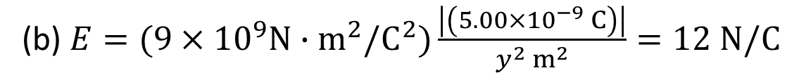
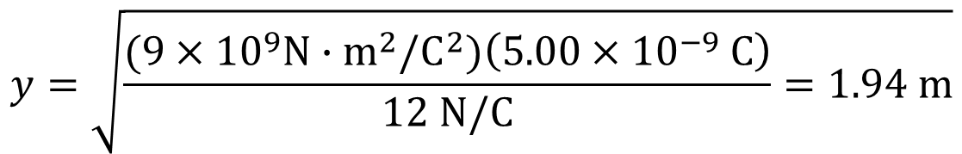
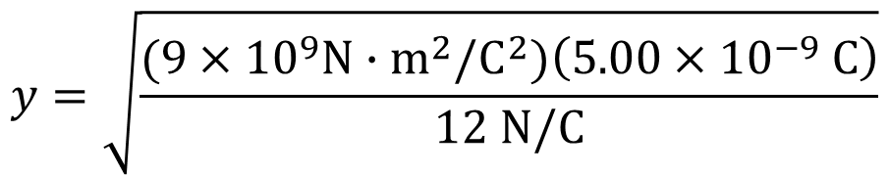
21.24 . A particle has charge -5.00 nC. (a) Find the magnitude and direction of the electric field due to this particle at a point 0.250 m directly above it. (b) At what distance from this particle does its electric field have a magnitude of 12.0 N/C?
(a) $E=(9×{10}^{9}N∙m^{2}/C^{2})\frac{\left|\left(5.00×{10}^{−9} C\right)\right|}{{0.250}^{2} m^{2}}=719 N/C$
(b) $E=(9×{10}^{9}N∙m^{2}/C^{2})\frac{\left|\left(5.00×{10}^{−9} C\right)\right|}{y^{2} m^{2}}=12 N/C$
0.250 m
$$y^{2}=(9×{10}^{9}N∙m^{2}/C^{2})\left(5.00×{10}^{−9} C\right)$$
-
$$y=\sqrt{\frac{(9×{10}^{9}N∙m^{2}/C^{2})\left(5.00×{10}^{−9} C\right)}{12 N/C}}$$
$$y=\sqrt{\frac{(9×{10}^{9}N∙m^{2}/C^{2})\left(5.00×{10}^{−9} C\right)}{12 N/C}=1.94 m}$$

Slide 6
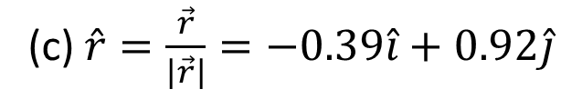
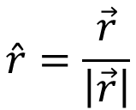
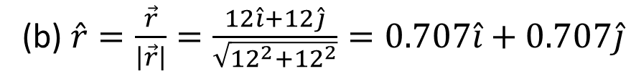
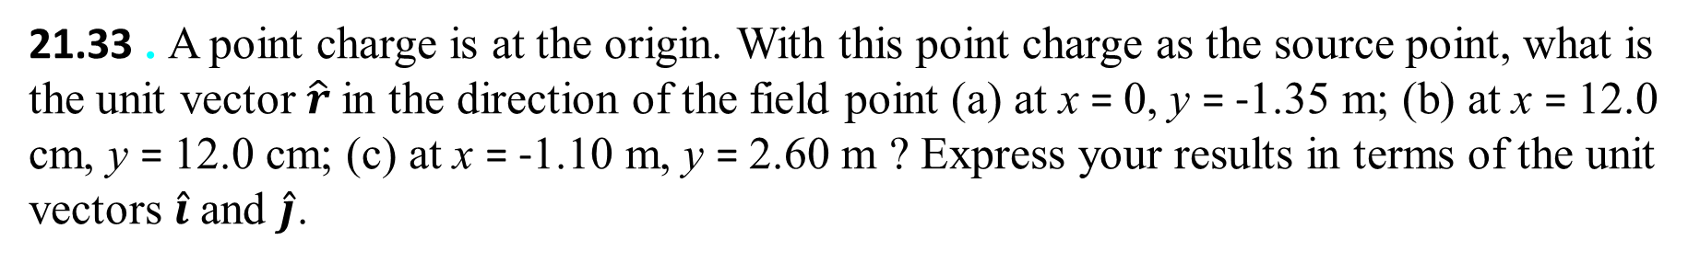
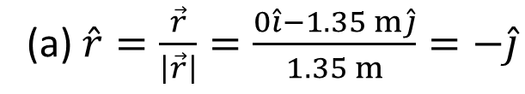


21.33 . A point charge is at the origin. With this point charge as the source point, what is the unit vector $\hat{r}$ in the direction of the field point (a) at x = 0, y = -1.35 m; (b) at x = 12.0 cm, y = 12.0 cm; (c) at x = -1.10 m, y = 2.60 m ? Express your results in terms of the unit vectors $\hat{i}$ and $\hat{j}$.
$$\hat{r}=\frac{\vec{r}}{\left|\vec{r}\right|}$$
$$\vec{r}=x\hat{i}+y\hat{j}$$
$$\left|\vec{r}\right|=\sqrt{x^{2}+y^{2}}$$
(a) $\hat{r}=\frac{\vec{r}}{\left|\vec{r}\right|}=\frac{0\hat{i}−1.35 m\hat{j}}{1.35 m}=−\hat{j}$
(b) $\hat{r}=\frac{\vec{r}}{\left|\vec{r}\right|}=\frac{12\hat{i}+12\hat{j}}{\sqrt{{12}^{2}+{12}^{2}}}=0.707\hat{i}+0.707\hat{j}$
(c) $\hat{r}=\frac{\vec{r}}{\left|\vec{r}\right|}=−0.39\hat{i}+0.92\hat{j}$

Slide 7
21.38 . The two charges q₁ and q₂ shown in Fig. E21.38 have equal magnitudes. What is the direction of the net electric field due to these two charges at points A (midway between the charges), B, and C if (a) both charges are negative, (b) both charges are positive, (c) q1 is positive and q₂ is negative.
E_{net}=E₁+E₂
E₁
E₂
E₂
E₁
E₁
E₂

Slide 8
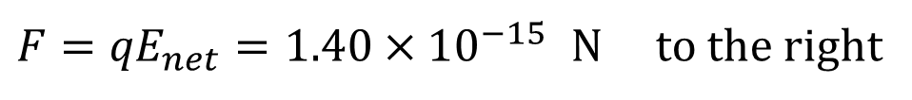
21.43 . Two point charges are separated by 25.0 cm (Fig. E21.43). Find the net electric field these charges produce at point A. (b) What would be the magnitude and direction of the electric force this combination of charges would produce on a proton at A?
q1=-6.25 nC
q2=-12.5 nC
E₁
E₂
-
-
x
10.0 cm
25.0 cm
$$E_{1}=(9×{10}^{9}N∙m^{2}/C^{2})\frac{\left|\left(−6.25×{10}^{−9} C\right)\right|}{{0.150}^{2} m^{2}}=2.50×{10}^{3} N/C$$
$$E_{2}=(9×{10}^{9}N∙m^{2}/C^{2})\frac{\left|\left(−12.5×{10}^{−9} C\right)\right|}{{0.150}^{2} m^{2}}=1.124×{10}^{4} N/C$$
$${E_{Net}=E}_{2}−E_{1}=1.124×{10}^{4}\frac{N}{C}−2.50×{10}^{3}\frac{N}{C}=8.74×{10}^{3}\frac{N}{C} to the right$$
${F=qE}_{net}=1.40×{10}^{−15 }N$ to the right

Slide 9
21.52 .. A straight, nonconducting plastic wire 8.50 cm long carries a charge density of +175 nC/m distributed uniformly along its length. It is lying on a horizontal tabletop. (a) Find the magnitude and direction of the electric field this wire produces at a point 6.00 cm directly above its midpoint. (b) If the wire is
now bent into a circle lying flat on the table, find the magnitude and direction of the electric field it produces at a point 6.00 cm directly above its center.
At a >> x

